Slide 1
Agenda
01 Introduction to Clustering
02 K-means
03 Customer Segmentation in Python
04 Gaussian Mixture models (If we have time)
05 Closing Q&A

Slide 2
Unsupervised learning
01
Supervised learning
Predict target value (“y”) given features (“x”)
Unsupervised learning
Understand patterns of data (just “x”)
Useful for many reasons
Data mining (“explain”)
Missing data values (“impute”)
Representation (feature generation or selection)
One example: clustering
Notes:
Meaningful clusters expand domain knowledge. For example, in the medical field, researchers applied clustering to gene expression experiments. The clustering results identified groups of patients who respond differently to medical treatments.
Useful clusters, on the other hand, serve as an intermediate step in a data pipeline. For example, businesses use clustering for customer segmentation. The clustering results segment customers into groups with similar purchase histories, which businesses can then use to create targeted advertising campaigns.

Slide 3
Introduction to Clustering
01

Slide 4
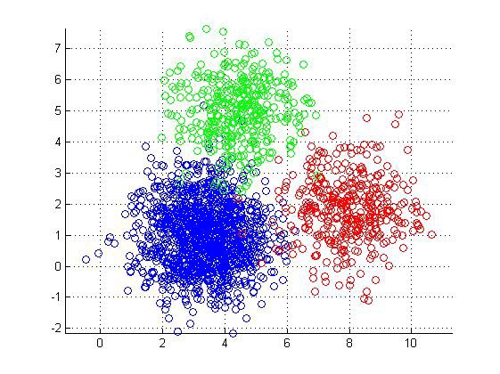
Clustering
01
What is Clustering
Clustering is the process of dividing the data space or data points into several groups, such that data points in the same groups are more similar to other data points in the same group,.
Clustering helps identify two qualities of data
Meaningfulness - Meaningful clusters expand domain knowledge.
Usefulness - Useful clusters serve as an intermediate step in a data pipeline.
Source: https://realpython.com/k-means-clustering-python/
Notes:
Meaningful clusters expand domain knowledge. For example, in the medical field, researchers applied clustering to gene expression experiments. The clustering results identified groups of patients who respond differently to medical treatments.
Useful clusters, on the other hand, serve as an intermediate step in a data pipeline. For example, businesses use clustering for customer segmentation. The clustering results segment customers into groups with similar purchase histories, which businesses can then use to create targeted advertising campaigns.

Slide 5
Clustering
01
Real-world applications of clustering:
Spam filter – e.g. spam emails identification
Marketing and Sales - identifying specific characteristics of a person and sharing campaigns with them that have been successful with other similar people.
Crime analysis.
Search result grouping - in the process of intelligent grouping of the files and websites. E.g. the metasearch engine called Yippy.
Recommendation Systems - recommend new items based on a user's tastes.
Finance - cluster analysis has been used to cluster stocks into sectors.
Medical Imaging – e.g. identifying Alzheimer’s disease (AD)
Source: https://en.wikipedia.org/wiki/Cluster_analysis#Applications
Notes:
Search result groupingIn the process of intelligent grouping of the files and websites, clustering may be used to create a more relevant set of search results compared to normal search engines like Google
Crime analysisCluster analysis can be used to identify areas where there are greater incidences of particular types of crime. By identifying these distinct areas or "hot spots" where a similar crime has happened over a period of time, it is possible to manage law enforcement resources more effectively.

Slide 6
Clustering
01
Some famous clustering algorithms are:
K-Means Clustering.
Hierarchical Clustering.
Mean-Shift Clustering.
Density-Based Spatial Clustering of Applications with Noise (DBSCAN).
Expectation-Maximization (EM) Clustering using Gaussian Mixture Models (GMM).
Source: https://www.kdnuggets.com/2019/09/hierarchical-clustering.html

Slide 7
Clustering
01
There are several ways to measure the distance between clusters in order to decide the rules for clustering
Complete-linkage: the distance between two clusters is defined as the longest distance between two points in each cluster.
Single-linkage: the distance between two clusters is defined as the shortest distance between two points in each cluster. This linkage may be used to detect high values in your dataset which may be outliers as they will be merged at the end.
Average-linkage: the distance between two clusters is defined as the average distance between each point in one cluster to every point in the other cluster.
Centroid-linkage: finds the centroid of cluster 1 and centroid of cluster 2, and then calculates the distance between the two before merging.
Source: https://www.kdnuggets.com/2019/09/hierarchical-clustering.html
Notes:
The choice of linkage method entirely depends on you and there is no hard and fast method that will always give you good results. Different linkage methods lead to different clusters.
The point of doing all this is to demonstrate the way hierarchical clustering works, it maintains a memory of how we went through this process and that memory is stored in Dendrogram.

Slide 8
K-means
02

Slide 9
K-Means
02
Unsupervised machine learning algorithm - type of algorithm that learns patterns from untagged data.
The goal in classification is to take an input vector x and to assign it to one of K discrete classes Ck where k = 1, . . . , K.
Iterative method to find clusters.
Classes are disjoint, so each input is assigned to one and only one class.
It is a vector quantization method often used as a clustering method.
“ A K-means clustering algorithm tries to group similar items in the form of clusters. The number of groups is represented by K.”
Notes:
k-means clustering tries to group similar kinds of items in form of clusters. It finds the similarity between the items and groups them into the clusters
Resource: https://realpython.com/k-means-clustering-python/

Slide 10
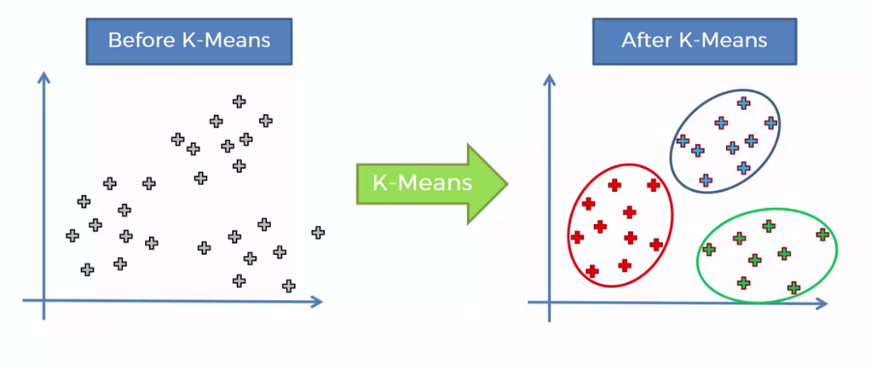
K-Means: What does it do?
02
Image from: https://towardsdatascience.com/k-means-clustering-identifying-f-r-i-e-n-d-s-in-the-world-of-strangers-695537505d

Slide 11
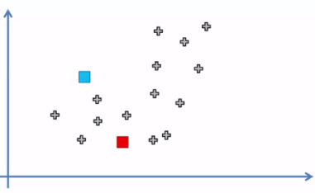
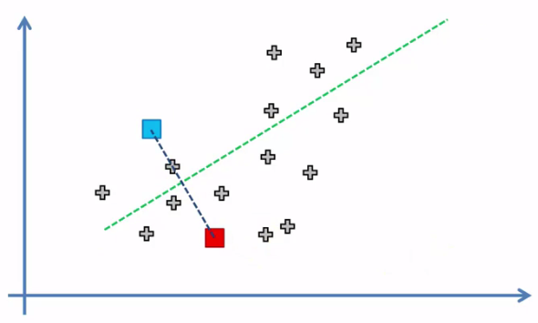
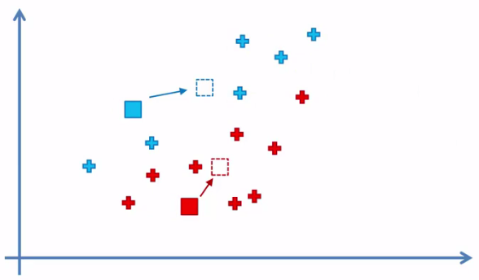
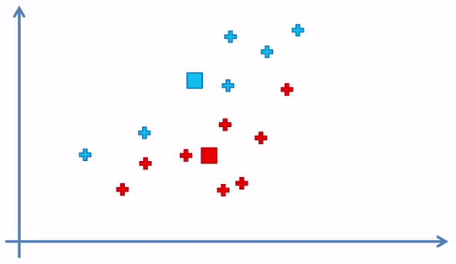
K-Means: The algorithm example
02
Gif Example: K-Means Iteration Convergence
Step 1: Choose initial points
Step 2: Connect centroids with a dotted line and ‘draw’ perpendicular line bisecting it, at the average point.
Step 3: Assign values to clusters and calculate the AVR of each cluster.
Step 4: Set new centroid points and go back to step 2.
Image from: https://www.analyticsvidhya.com/blog/2020/10/a-simple-explanation-of-k-means-clustering/
Notes:
Source: https://towardsdatascience.com/k-means-clustering-identifying-f-r-i-e-n-d-s-in-the-world-of-strangers-695537505d
In step 3, basically we have to check that for every data point in our dataset, identify which of the two centroids(Blue or Red) is the closest. This we will determine by refreshing our geometry knowledge. What we’re going to do is we connect those centroids with straight line and bisect that line with a perpendicular(marked in yellow).Any point on yellow line is equidistant from both centroids. Points lying above the line belongs to blue cluster centroid and likewise points lying below the line belongs to red cluster centroid. For simplicity purpose points of clusters that they belong will be painted in same colors. Before we continue further again I would like to mention “closest” is an ambiguous term. Because closest when you visualize things on scatter plot is pretty straight forward implies that the distance we’re looking at. From scatter plot we can very well conclude that point x is closer to cluster A and point y is closer to cluster B.

Slide 12
K-Means: The algorithm in detail
02
Goal: Minimize the our objective function.
For our objective function, which measures the quality of a clustering, we use the sum of the squared error (SSE), which is also known as scatter.
Calculate the error of each data point, i.e., its Euclidean distance to the closest centroid, and then compute the total sum of the squared errors.
Given two diﬀerent sets of clusters that are produced by two diﬀerent runs of K-means, we prefer the one with the smallest squared error, since this means that the prototypes (centroids) of this clustering are a better representation of the points in their cluster.
Note that: there are some other distance measures like Manhattan, Jaccard, and Cosine which are used based on the appropriate type of data.
Source: https://heartbeat.fritz.ai/understanding-the-mathematics-behind-k-means-clustering-40e1d55e2f4c

Slide 13
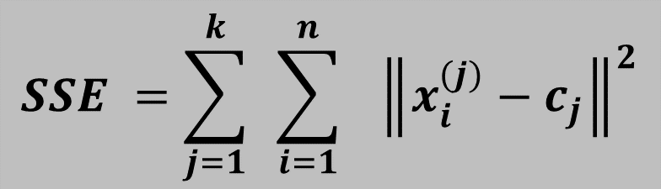
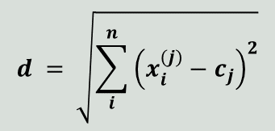
K-Means: The Objective Function
02
Number of clusters
Number of cases
Case i
Centroid for cluster j
$$SSE =\sum_{j=1}^{k}{ }\sum_{i=1}^{n}{ } {\left\|x_{i}^{(j)}−c_{j}\right\|}^{2}$$
Dataset has n values.
K number of clusters
Centroids (centre points) as c.
Objective function
SSE
$$d = \sqrt{\sum_{i}^{n}{{\left(x_{i}^{(j)}−c_{j}\right)}^{2}}}$$
Distance function
The sum of squared deviations from centroid is equal to the sum of pairwise squared Euclidean distances divided by the number of points.
Source: https://heartbeat.fritz.ai/understanding-the-mathematics-behind-k-means-clustering-40e1d55e2f4c
Notes:
The difference between Euclidean distances vs Cosine one in Python, article: https://cmry.github.io/notes/euclidean-v-cosine

Slide 14
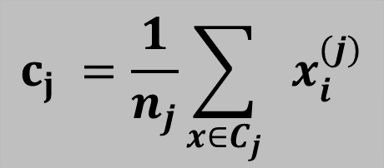
K-Means: The Objective Function
02
Given our data in Euclidean space, it can be shown that the centroid that minimizes the SSE of the cluster is the mean.
Case i in the jth cluster
Centroid for cluster j
$$c_{j} =\frac{1}{n_{j}}\sum_{x∈C_{j}}{ }x_{i}^{(j)}$$
For example
Given the three data points
(1,1), (2,3) and (6,2)
The centroid containing these 2D points is
(1+2+6)/3 = 3
(1+3+2)/3 = 2
Which is the point (3,2).
Number of data points in jth cluster
Source: https://heartbeat.fritz.ai/understanding-the-mathematics-behind-k-means-clustering-40e1d55e2f4c
Notes:
The difference between Euclidean distances vs Cosine one in Python, article: https://cmry.github.io/notes/euclidean-v-cosine

Slide 15
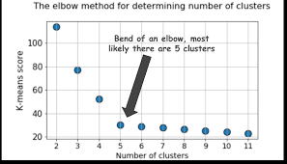
K-Means: Choosing K clusters
02
The elbow method.
In this method we will run K-Means clustering for a range of K values lets say ( K= 1 to 10 ) and calculate the Sum of Squared Error (SSE).
The point where this distortion declines the most is the elbow point, which works as an optimal value of k.
Source: https://heartbeat.fritz.ai/understanding-the-mathematics-behind-k-means-clustering-40e1d55e2f4c

Slide 16
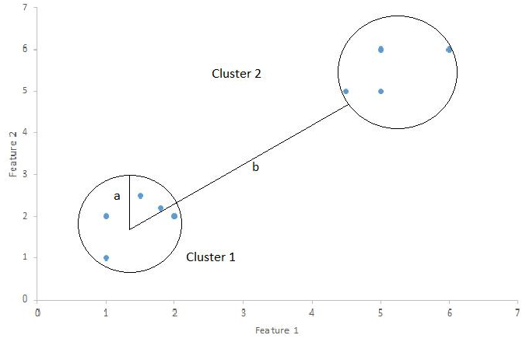
K-Means: Choosing K clusters
02
The Silhouette Method.
Metric used to calculate the goodness of a clustering technique.
It ranges from -1 to 1.
It quantifies how well a data point fits into its assigned cluster based on two factors:
Cohesion: How close the data point is to other points in the cluster
Separation: How far away the data point is from points in other clusters
Source: https://towardsdatascience.com/silhouette-coefficient-validating-clustering-techniques-e976bb81d10c
Notes:
See video: https://www.youtube.com/watch?v=aOnKnLM4eok

Slide 17
K-Means: Choosing K clusters
02
The Silhouette Method.
-1: the samples might have been assigned to the wrong cluster!
0: the sample is on or very close to the decision boundary between two neighboring clusters.
1: the sample is far away from the neighboring clusters.
Larger ‘numbers’ indicate that samples are closer to their clusters than they are to other clusters.
Source: https://scikit-learn.org/stable/auto_examples/cluster/plot_kmeans_silhouette_analysis.html
Notes:
See video: https://www.youtube.com/watch?v=aOnKnLM4eok

Slide 18
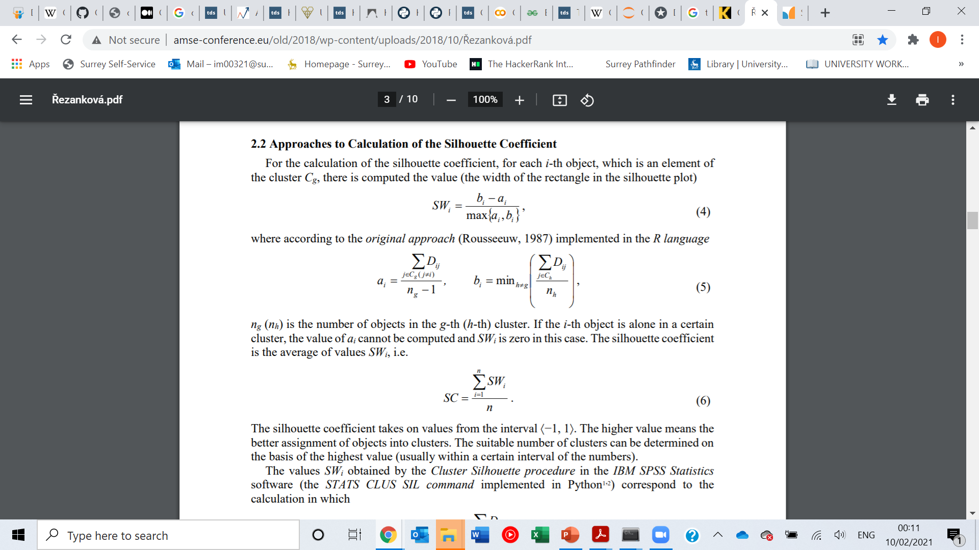
K-Means: Choosing K clusters
02
The Silhouette Method.
Source: http://www.amse-conference.eu/old/2018/wp-content/uploads/2018/10/%C5%98ezankov%C3%A1.pdf
Notes:
See video: https://www.youtube.com/watch?v=aOnKnLM4eok

Slide 19
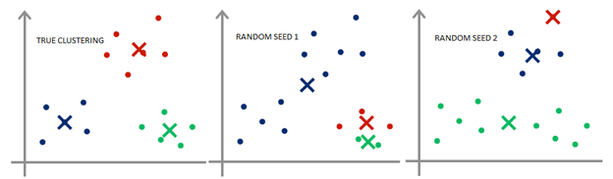
K-Means: Choosing initial Centroids
02
Choosing the proper initial centroids is the key step of the basic K-means procedure. A common approach is to choose the initial centroids randomly, but the resulting clusters are often poor.
One way of dealing with this is to perform multiple runs, each with a diﬀerent set of randomly-chosen initial centroids, and then select the set of clusters with the minimum SSE.

Slide 20
K-Means
02
Strengths
K-means clustering is relatively simple to implement, and can be implemented without using frameworks—just simple programming language, specifying one’s own proximity measures.
The algorithm is known to easily adapt to new examples.
It guarantees convergence by trying to minimize the total SSE as an objective function over a number of iterations.
The algorithm is fast and efficient in terms of computational cost, which is typically O(I∗K∗m∗n), where I is the number of iterations, K is the number of clusters, n is the number of points, m is the number of attributes.
The space requirements for k-means clustering are modest, because only the data points and centroids are stored. Storage required is O((n + K)m).
Notes:
https://heartbeat.fritz.ai/understanding-the-mathematics-behind-k-means-clustering-40e1d55e2f4c

Slide 21
K-Means
02
Weaknesses
Choosing k manually. This is the greatest factor in the convergence of the algorithm and can provide widely different results for different values of k.
Clustering data of varying sizes and density. K-means doesn’t perform well with clusters of different sizes, shapes, and density. To cluster such data, you need to generalize k-means.
Clustering outliers. Outliers must be removed before clustering, or they may affect the position of the centroid or make a new cluster of their own.
Being dependent on initial values. As the value of k increases, other algorithms(i.e. k-means seeding) need to be applied to give better values for the initial centroids.
Scaling with number of dimensions. As the number of dimensions increases, the difficulty in getting the algorithm to converge increases due to the curse of dimensionality, discussed above.
If there is overlapping between clusters, k-means doesn’t have an intrinsic measure for uncertainty; thus it’s difficult to identify which points in the overlapping region should be assigned to which class.
Notes:
https://heartbeat.fritz.ai/understanding-the-mathematics-behind-k-means-clustering-40e1d55e2f4c

Slide 22
Customer Segmentation in Python
03

Slide 23
Gaussian Mixture Models
04

Slide 24
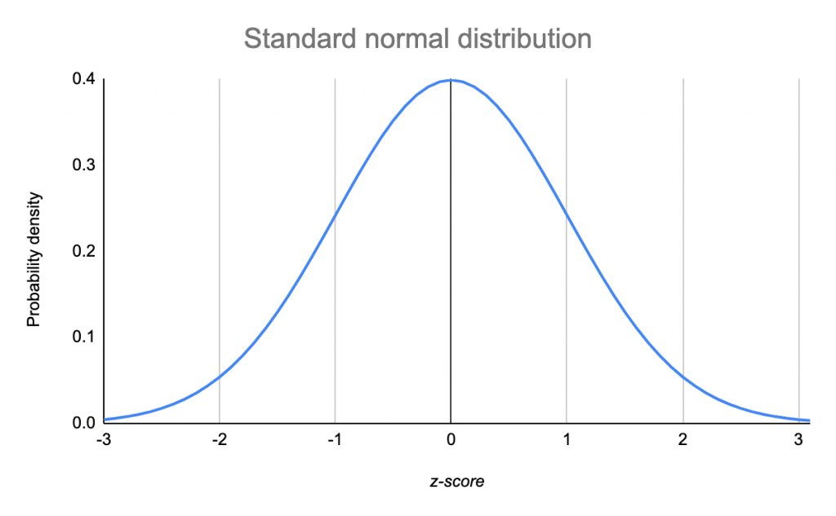
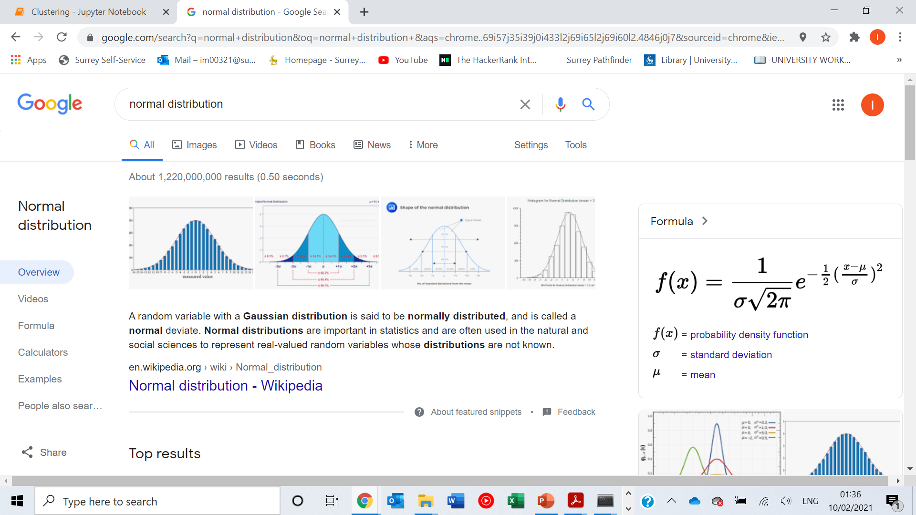
Gaussian Mixture Models
04
The normal distribution – 1D case.
.

Slide 25
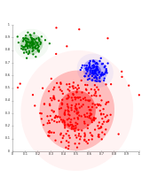
Gaussian Mixture Models
04
Introduction:
Assumes all the data points are generated from a mixture of a finite number of Gaussian distributions with unknown parameters.
One can think of mixture models as generalizing k-means clustering to incorporate information about the covariance structure of the data as well as the centres of the latent Gaussians.
Source: https://scikit-learn.org/stable/modules/mixture.html#:~:text=A%20Gaussian%20mixture%20model%20is,Gaussian%20distributions%20with%20unknown%20parameters.

Slide 26
Gaussian Mixture Models
04
K-Means vs. Gaussian Mixture Models
K-Means Clustering: K means clustering is fast. It produces best results when clusters when the clusters are more spread out. It divides clusters as perfect circles, and strictly assigns a single cluster to each entry.
Gaussian Mixture Model: Gaussian Mixture model has a greater number of parameters and it is therefore less efficient. It is good for clustering with uneven shapes. Assigns a probability that a point belongs to a cluster.
What if clusters are overlapping?
Hard to tell which cluster is right
Maybe we should try to remain uncertain.
Source: https://scikit-learn.org/stable/modules/mixture.html#:~:text=A%20Gaussian%20mixture%20model%20is,Gaussian%20distributions%20with%20unknown%20parameters.

Slide 27
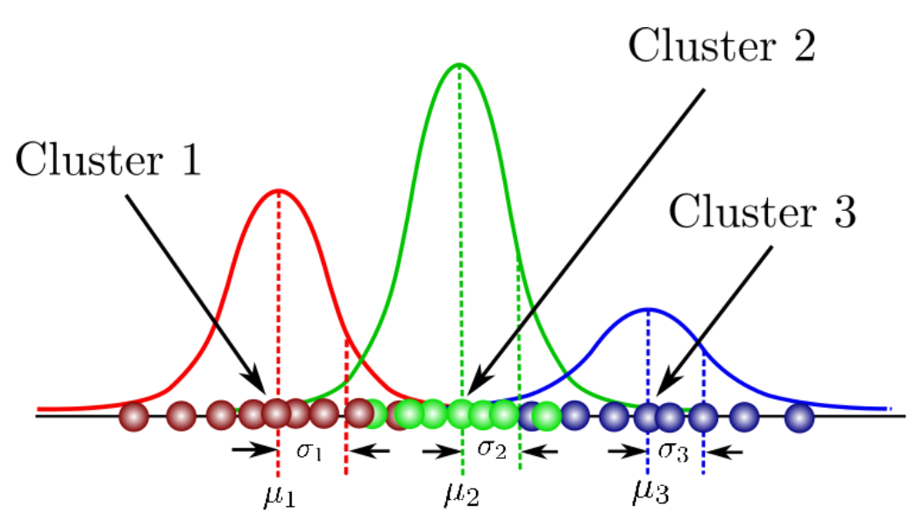
Gaussian Mixture Models
04
Mixed Normal Models – 3 Normal Distributions.
Source: https://towardsdatascience.com/gaussian-mixture-models-explained-6986aaf5a95.

Slide 28


Gaussian Mixture Models
04
Definitions
A Gaussian Mixture is a function that is comprised of several Gaussians, each identified by k ∈ {1,…, K}, where K is the number of clusters of our dataset.
Parameters:
A mean μ that defines its centre.
A variance $σ^{2}$ (covariance Σ) that defines its width. This would be equivalent to the dimensions of an ellipsoid in a multivariate scenario.
A mixing probability π that defines how big or small the Gaussian function will be.
$$\sum_{j=1}^{k}{π_{j}}=1$$
Source: https://scikit-learn.org/stable/modules/mixture.html#:~:text=A%20Gaussian%20mixture%20model%20is,Gaussian%20distributions%20with%20unknown%20parameters.

Slide 29
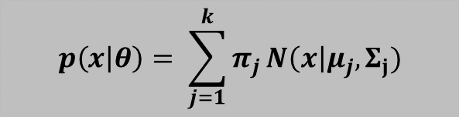


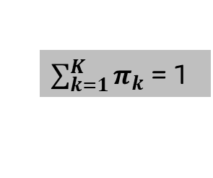
Gaussian Mixture Models
04
We need to determine what are the optimal values of the parameters?
The Gaussian Mixture Model is then defined as:
We need to find the ‘best’ $μ$ that minimizes the sum of squares ${\left(x−μ\right)}^{2}/σ^{2}$ (1D case)
$$p\left(x | θ\right)= \sum_{j=1}^{k}{π_{j}}N\left(x\right|μ_{j},Σ_{j})$$
$$0<π_{j}<1$$
$\sum_{k=1}^{K}{π_{k}}$ = 1
Source: https://scikit-learn.org/stable/modules/mixture.html#:~:text=A%20Gaussian%20mixture%20model%20is,Gaussian%20distributions%20with%20unknown%20parameters.

Slide 30
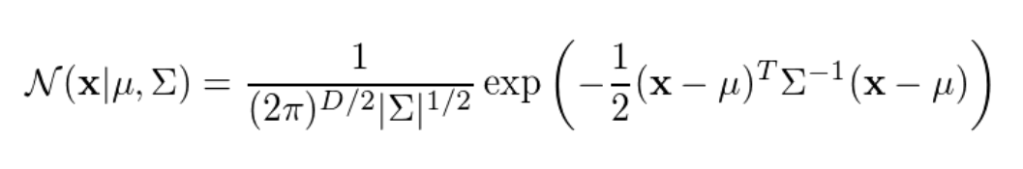
Gaussian Mixture Models
04
The Multivariate Gaussian Density function is:
X is our data points (can be a D-dimensional vector for one feature).
E.g. If we have a dataset comprised of N = 1000 three-dimensional points (D = 3), then x will be a 1000 × 3 matrix, μ will be a 1 × 3 vector, and Σ will be a 3 × 3 matrix.
Source: https://scikit-learn.org/stable/modules/mixture.html#:~:text=A%20Gaussian%20mixture%20model%20is,Gaussian%20distributions%20with%20unknown%20parameters.

Slide 31
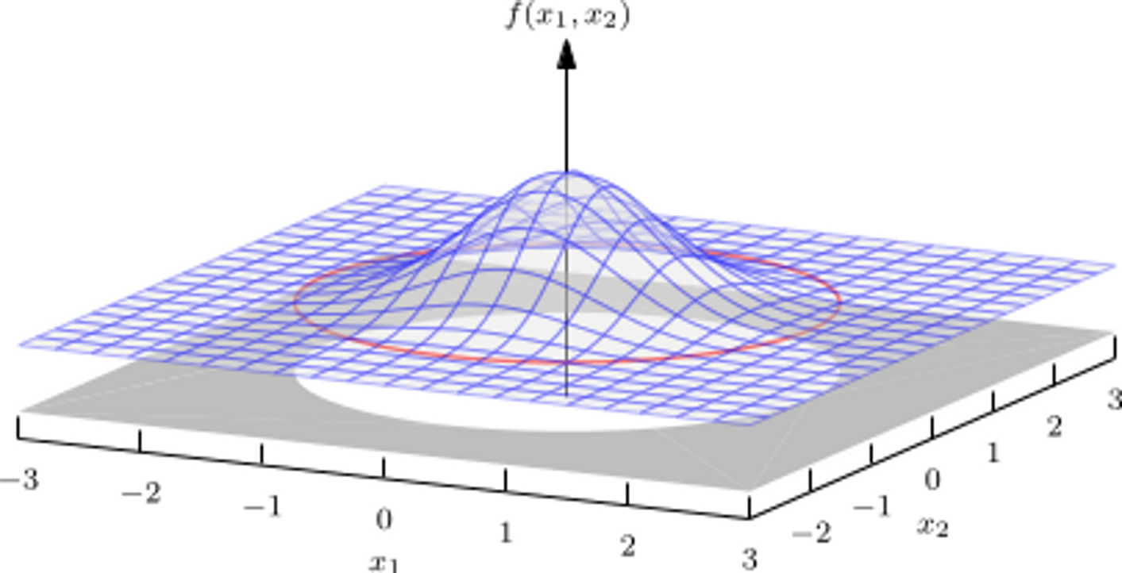
Gaussian Mixture Models
04
Multivariate Normal Distribution
Source: https://scikit-learn.org/stable/modules/mixture.html#:~:text=A%20Gaussian%20mixture%20model%20is,Gaussian%20distributions%20with%20unknown%20parameters.

Slide 32
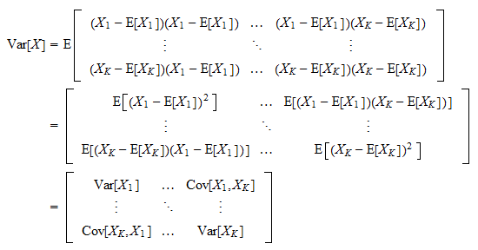
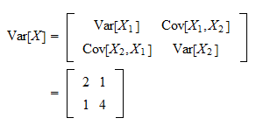
Gaussian Mixture Models
04
Variance –Covariance matrix
2-variable Covariance matrix
Source: https://scikit-learn.org/stable/modules/mixture.html#:~:text=A%20Gaussian%20mixture%20model%20is,Gaussian%20distributions%20with%20unknown%20parameters.

Slide 33
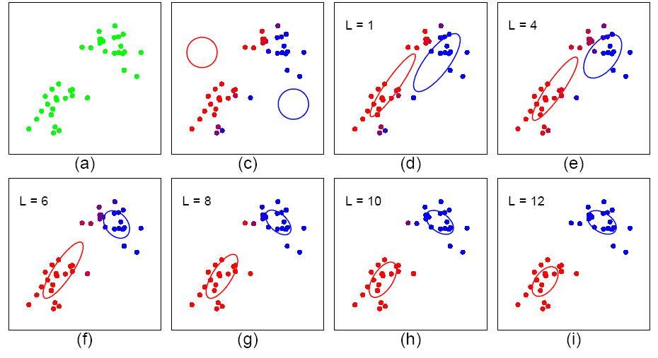
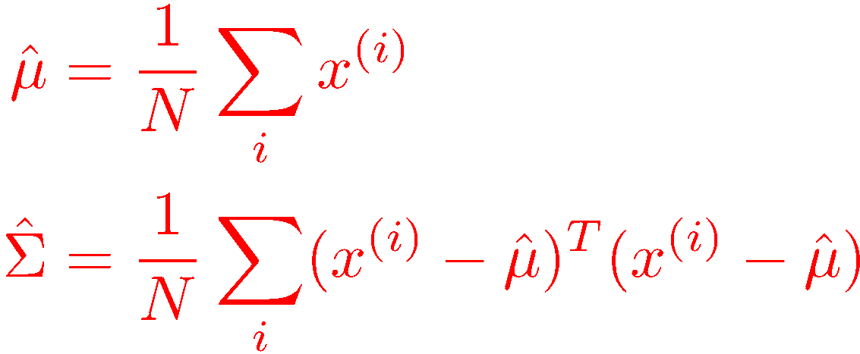
Gaussian Mixture Models
04
Maximum Likelihood estimates

Slide 34
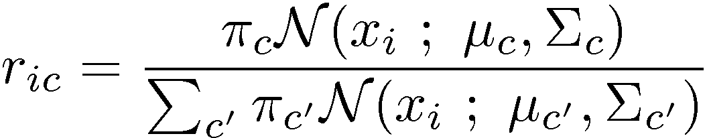

Gaussian Mixture Models
04
Start with parameters describing each cluster: Mean, Covariance, “size”
E-step (“Expectation”):
For each datum (example) $x_{i}$,
Compute $r_{ic}$, the probability that it belongs to cluster c
Compute its probability under model c
Normalize to sum to one (over clusters c)
If $x_{i}$ is very likely under the c-th Gaussian, it gets high weight.
Denominator just makes $r_{ic}$’s sum to one.

Slide 35
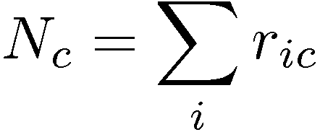
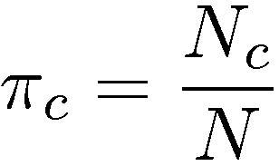
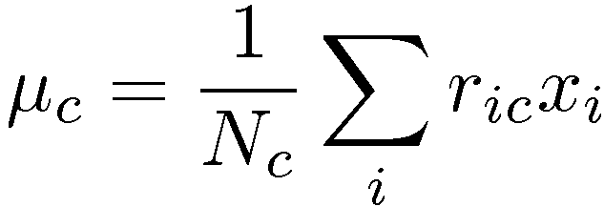
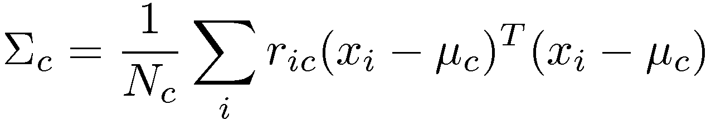

Gaussian Mixture Models
04
EM Algorithm: M-step:
Start with assignment probabilities $r_{ic}$
Update parameters: mean, Covariance, “size”
M-step (“Maximization”)
For each cluster (Gaussian) $x_{c}$,
Update its parameters using the (weighted) data points
Iterate until convergence.
Total responsibility allocated to cluster c
Fraction of total assigned to cluster c
Weighted mean of assigned data
Weighted covariance of assigned data
(use new weighted means here)

Slide 43
Closing Q&A
05
Thank you.

